Slide 1

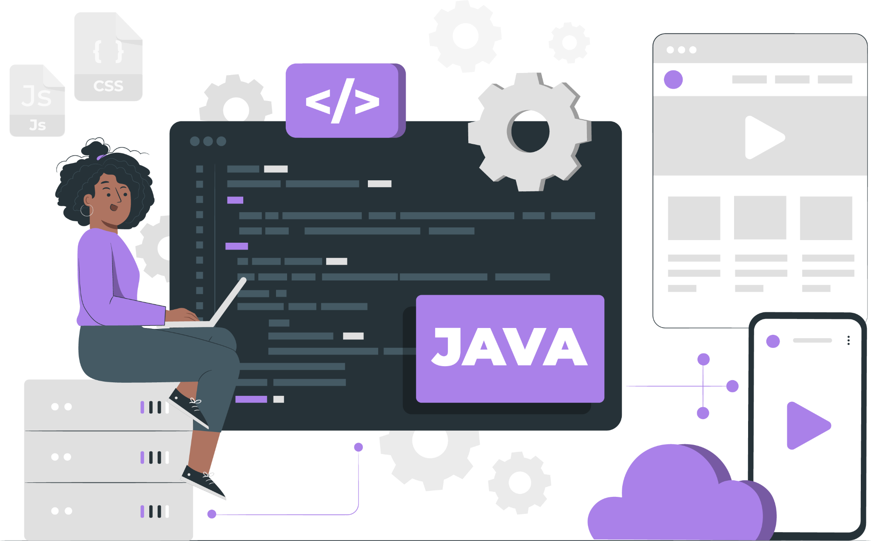
Lecture - 11
Arrays in Java

Slide 2
List of Concepts Involved:
Why an array?
What is an Array?
How to create an array?
1d, 2d, and jagged Arrays with memory

Slide 3
Topics covered Yesterday's Session:
OOPs Fundamentals

Slide 4
Why Array?
If we use a traditional approach, then to store 5 values we need to create 5 variables.
Similarly to store 100 values we need to create 100 variables.
The drawback in the traditional approach is that remembering the variables names is complex, so to avoid this problem we need to use “Arrays”.

Slide 5
What is an Array?
It refers to index collection of fixed number of homogeneous data elements.
Single variable holding multiple values which improves readability of the program.

Slide 6
How to create an array?
Array declarations:
1-Dimensional Array
2-Dimensional Array
Jagged Arrays
1-D Array: Declaration of array
int[] a;//recommended to use as variable is separated from type.
int a[];
int []a;
int[6] a; // compile time error. we cannot specify the size.

Slide 7
Array Construction:
Every array in java is an object hence we create using a new operator.
Array Initialisation: Since arrays are treated as objects,internally based on the type of data we keep inside array
JVM will keep default values.
Shortcut way of declaration,construction,initialisation in single line:
int []a = {10,20,30,40};
char [] a= {'a','e','i','o','u'};
String[] a= {"sachin","ramesh","tendulkar","IND"};

Slide 8
2-D Array:
2D-Array = 1D - Array + 1D - Array
(ref) (data)
Declaration(All are valid)
int[][] a ;
int a[][];
int [][]a;
int[] []a;
int[] a[];
int []a[];

Slide 9
2-D Array:
Array Construction:
int[][] a = new int[3][2];
or
int[][] a = new int[3][];
a[0] = new int[5];
a[1] = new int[3];
a[2] = new int[1];
Array Initialization:
a[0][0] = 10;
a[2][3] = 5;

Slide 10
For-each/Enhanced For loop
The for-each loop in Java go through each element of the array individually. It runs the body of the loop after holding an element of the array in a variable.
The syntax of the for-each loop is given below:
for(data_type variable:array){
//body of the loop
}

Slide 11
Next Lecture
Different ways to create an Array
Buffer overrun and ArrayIndexOutOfBoundsException
Disadvantages of Array in Java

Slide 12
THANK YOU

